Slide 1

lesson 10
  Measuring Drive Performance

Slide 2
This lesson includes the following sections:
    Average Access Time
    File Compression
    Data-Transfer Rate
    Drive-Interface Standards

Slide 3
Average Access Time
In storage devices, average access time (or seek time) is the time required for a read/write head to move to a spot on the storage medium.
For storage devices, access time is measured in milliseconds (ms), or thousandths of a second. In memory, access time is measured in nanoseconds (ns), or one-billionths of a second.
Diskette drives offer an average access time of 100 ms. Hard drives are faster, usually between 6 – 12 ms.

Slide 4
Typical Access Times for Memory and Storage Devices
Device | Typical Access Time
Static RAM (SRAM) | 5-15 ns
Dynamic RAM (DRAM) | 50-70 ns
Read only memory (ROM) | 55-250 ns
Hard disk drives | 6-12 ms
CD ROM drives | 80-800 ms
Tape drives | 20-500 s

Slide 5



File Compression
File compression technology shrinks files so they take up less disk space.
Using a compression utility, you can shrink multiple files into a single archive file.
Utilities such as Windows' DriveSpace enable you to compress the entire contents of your hard disk.
My archive

Slide 6
Data-Transfer Rate
Data-transfer rate (or throughput) measures the time required for data to travel from one device to another.
If a device transfers 45,000 bytes per second, its data-transfer rate is 45 KBps.
Hard disks offer the fastest data-transfer rates of any storage device.

Slide 7

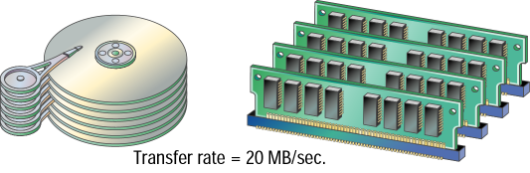

Slide 8
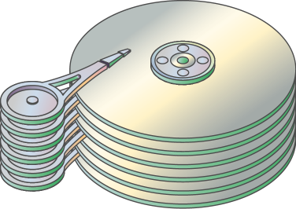
Hard Disk Fragmentation
One file can end up fragmented
(scattered) over the disk surface.

Slide 9
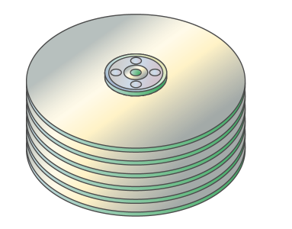
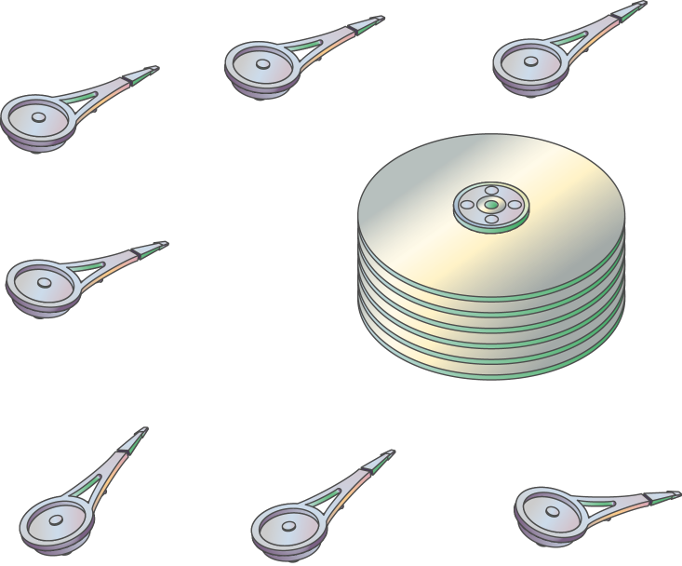
Hard Disk Fragmentation
This results in multiple head accesses
which degrades performance.

Slide 10
Drive-Interface Standards
All PCs use a disk controller as an interface between a disk drive and the CPU. The two most common interface standards are EIDE (Enhanced Integrated drive electronics) and SCSI (Small Computer System Interface).
EIDE has evolved over the years and has several variants, all of which have different names.
SCSI is a faster, more flexible drive-interface standard found in high-performance computers.

Slide 11
lesson 10 Review
Define average access time and explain how it is measured.
Explain why file compression is a factor in drive performance.
Define data transfer rate and describe how it is measured.
Identify two drive interface standards.

